Slide 1
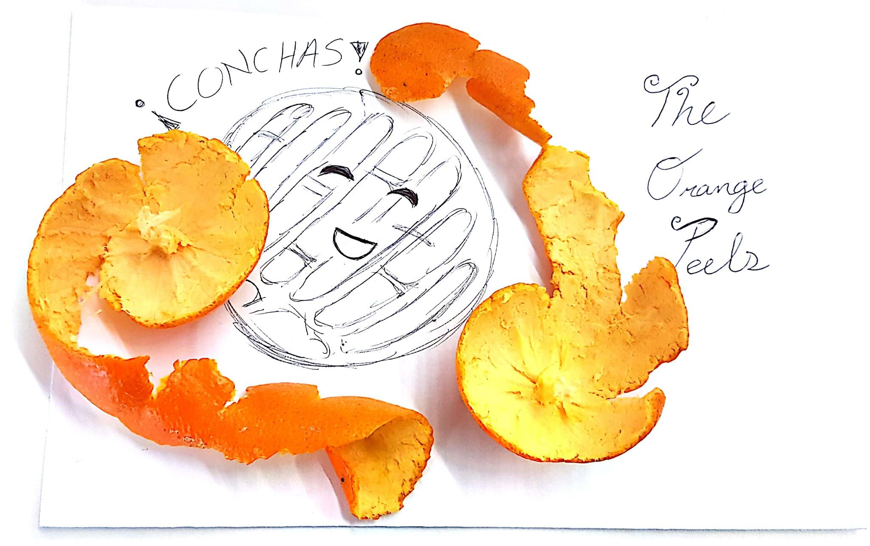
Antonio Hinojosa
Samantha Velazquez
Sam Rang
Eric Sherman
Jose Vidal
Armando Gonzalez

Slide 2
Our Inspirational Sources
Jose: I picked the Concha for many reasons but the most important was because of the fact that it brings my family together.
Armando: The reason i picked the yo-yo because when i was little i always watched people doing tricks with it.So i asked my mom to buy me one.Instead buying the yo-yo from here my mom asked my grandma to buy one from Mexico. It was weird how stuff are made because the yo-yo was hand made.

Slide 3
Why the Orange Peels Picked the Concha and The Yoyo
Both items hit close to home to most of us, we grew up with these objects.
The other reason is Conchas are delicious and you cannot pass up the opportunity to taste them.
As for the Yoyo we thought we could make a cool sound out of it.

Slide 4
Process
We chose to sample sounds of the word “CON - CHA” and of the vibrations of the yoyo string.
We recorded the sounds of the concha itself using a contact microphone, and a Zoom field recorder.
These samples are small recordings of a few seconds (one shots).
The samples were then processed and uploaded to be used in various contexts (web app, DAW, standalone sequencer, sample player, etc)

Slide 5
Performance and shared experiences!
http://bit.ly/2zE5GHo
Interactive Web App! (TECHNOLOGY<3)
Using Audio from our samples (AUTHENTIC <3)
G.I.F images we recorded to go with the audio of the actual objects sampled (AUTHENTIC & CREATIVE <3)
https://www.youtube.com/watch?v=cpoILTSmJNA
Visual of sample remix (CREATIVE <3)
Live Performance (VERSATILE <3)

Slide 6
Thank You!

